Slide 1
Istio with Kiali
OW

Slide 2
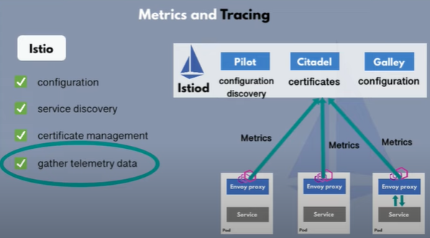
Data visualization
Monitor and visualize the data

Slide 3
Integration options
https://istio.io/latest/docs/ops/integrations/
Kiali is an observability console for Istio with service mesh configuration and validation capabilities. It helps you understand the structure and health of your service mesh by monitoring traffic flow to infer the topology and report errors.
Deploy Kiali
kubectl apply -f https://raw.githubusercontent.com/istio/istio/release-1.15/samples/addons/kiali.yaml
Change the svc from clusterip to NodePort

